Slide 1

Layout with Image, View, TextInput
In this lession, you will learn:
- Design some basic screen
- How to download and add custom fonts
- Make child components clickable
- Customize button, Image, Underlined Text
- Customize font’s icons and Image’s icons

Slide 2
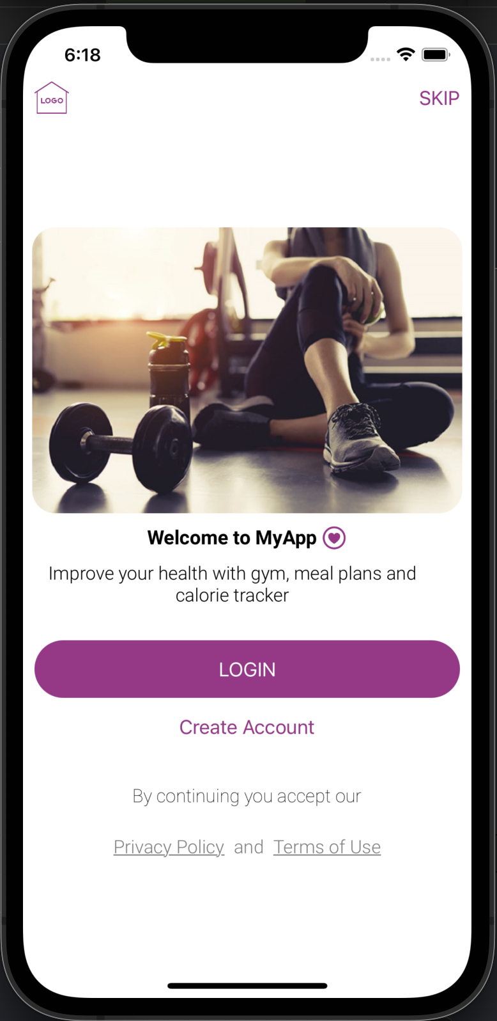
Example of WelcomeScreen
Write a Wecome Screen:
- Component can be a function/class
- There are some components which can be clickable: Skip, Login, Create Account, Policy Privacy, Term of Use
- Alert and show messages when pressing on buttons

Slide 3
UI Guide(Horizontal Stack, Image)
HStack {
Image(Icons.logo)
.renderingMode(.template)
.resizable()
.aspectRatio(contentMode: .fit)
.frame(height: 30)
.foregroundColor(Colors.primary)
.padding(.leading, 10)
Spacer()
Button(action: {
print("Hello World")
}) {
Text("SKIP").foregroundColor(Colors.primary)
}.padding(.trailing, 10)
}

Slide 4
Define some global variables
-Drag and drop some images to Assets.xcassets
- Pick RGB’s values of colors
//In Colors.swift
class Colors{
static var primary = Color(red: 171/255, green: 48/255, blue: 138/255)
static var inactive = Color(red: 127/255, green: 127/255, blue: 127/255)
//ab308a
}
//In Icons.swift
class Icons{
static var logo = "logo"
static var back = "icon-back"
//other variables
}

Slide 5
UI Guide(Horizontal Stack, Image)
HStack {
Spacer()
Image(Images.welcome)
.renderingMode(.original)
.resizable()
.aspectRatio(contentMode: .fit)
.cornerRadius(20)
Spacer()
}
HStack {
Spacer()
Text("Welcome to MyApp")
.font(Font.custom("Roboto-Bold", size: 17))
Image(systemName: "heart.circle")
.font(Font.system(size: 20))
.foregroundColor(Colors.primary)
.padding(.leading, -5)
Spacer()
}

Slide 6
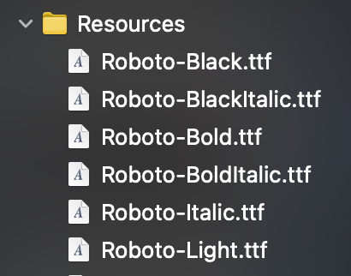
Add custom fonts to your App
-Download fonts, drag and drop them to Resources group
- Pick RGB’s values of colors
//You can use any custom fonts from anywhere in your App
Text("Welcome to MyApp")
.font(Font.custom("Roboto-Bold", size: 17))
//You can show all font’s names
.onAppear(perform: {
for fontFamily in UIFont.familyNames {
for fontName in UIFont.fontNames(forFamilyName: fontFamily) {
print("\(fontName)")
}
}

Slide 7
UI Guide(Horizontal Stack, Image)
Button(action: {
print("login")
}) {
Text("LOGIN")
.frame(maxWidth: .infinity, minHeight: 50)
.foregroundColor(.white)
.background(Colors.primary)
.clipShape(RoundedRectangle(cornerRadius: 25))
.padding(.leading, 10)
.padding(.trailing, 10)
}
Button(action: {
print("Create account")
}) {
Text("Create Account")
.frame(maxWidth: .infinity, minHeight: 50)
.foregroundColor(Colors.primary)
.clipShape(RoundedRectangle(cornerRadius: 25))
.padding(.leading, 10)
.padding(.trailing, 10)
.padding(.top, -10)
}

Slide 8
UI Guide(Horizontal Stack, custom fonts)
HStack(alignment:.center {
Spacer()
Button(action: {
}) {
Text("Privacy Policy")
.font(Font.custom("Roboto-Light", size: 16))
.foregroundColor(Colors.inactive)
.underline()
}
Text("and")
.font(Font.custom("Roboto-Light", size: 16))
.foregroundColor(Colors.inactive)
Button(action: {
}) {
Text("Terms of Use")
.font(Font.custom("Roboto-Light", size: 16))
.foregroundColor(Colors.inactive)
.underline()
}
Spacer()
}

Slide 9
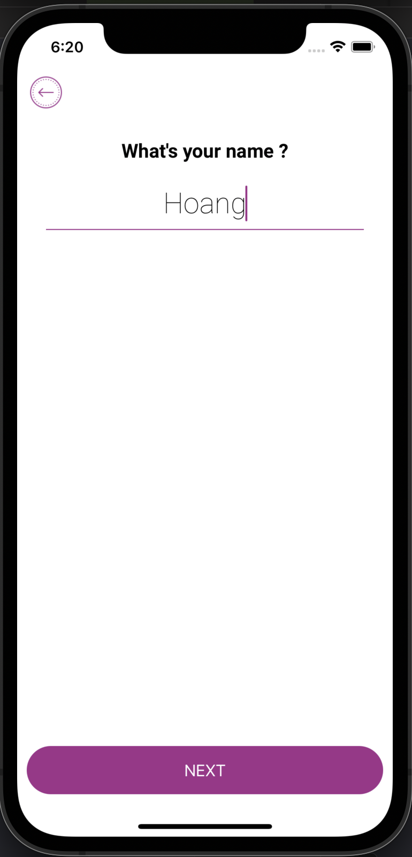
Screen with states
//states are internal variables, when it changes, the UI will refresh
@State var name: String = ""
//when Text changes, the states also change when user types
TextField("", text: Binding<String>(get: {self.name}, set: {
//when User types text, this code run,
//$0 is what you typed
name = $0
error = (name.count < 3) ? "Name must be at least 3 characters" : ""
}))
.disableAutocorrection(true)
.padding(.leading, 20)
.padding(.trailing, 20)
.multilineTextAlignment(.center)
.font(Font.custom("Roboto-Thin", size: 30))

Slide 10
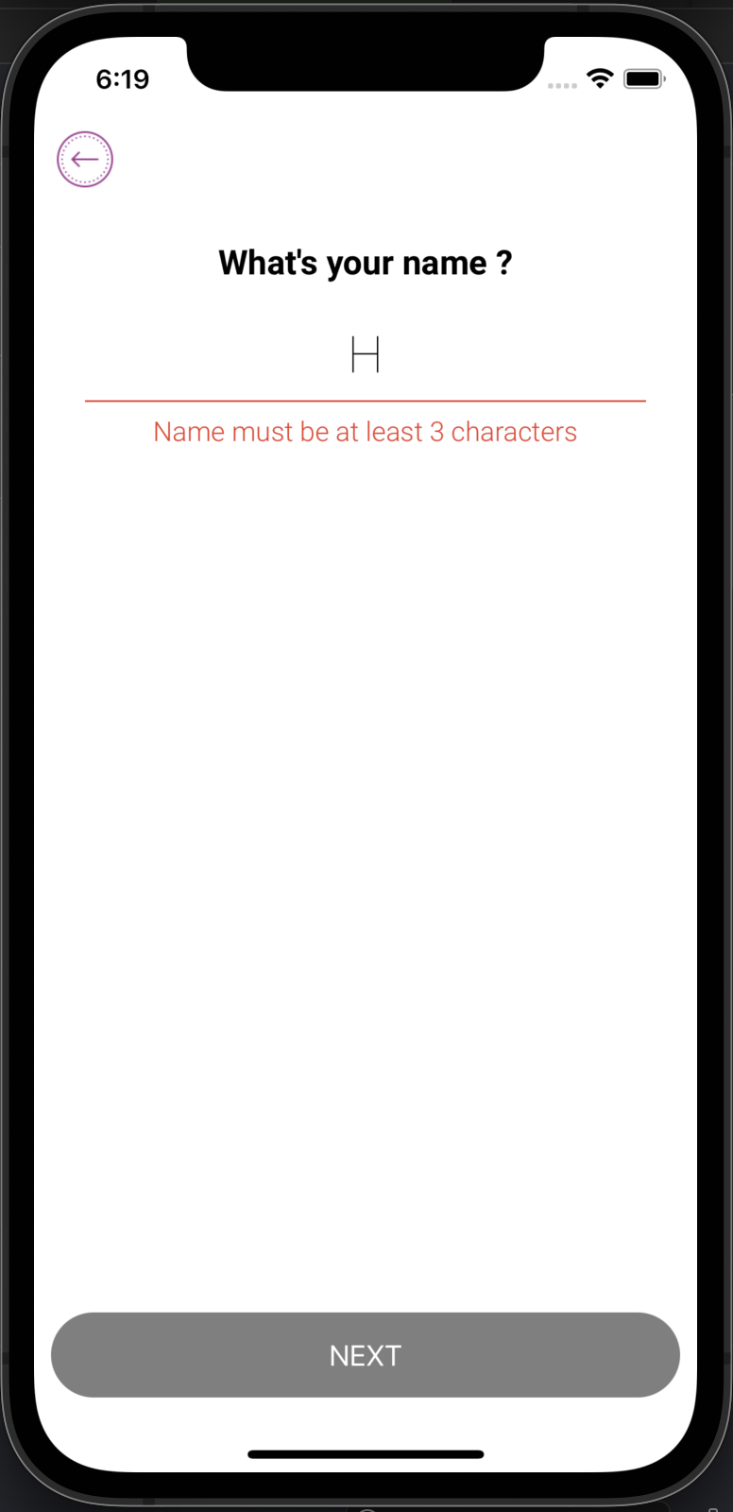
Customize InputName screen
Rectangle()
.fill(error == "" ? Colors.primary : .red)
.frame(height: 1, alignment: .center)
.padding(.leading, 30)
.padding(.trailing, 30)
Text(error)
.frame(maxWidth: .infinity, alignment: .center)
.font(Font.custom("Roboto-Light", size: 16))
.multilineTextAlignment(.center)
adding(.leading, 10)
.foregroundColor(.red)
Button(action: {
print("login")
}) {
Text("NEXT")
.frame(maxWidth: .infinity, minHeight: 50)
.foregroundColor(.white)
.background(“????”)
.clipShape(RoundedRectangle(cornerRadius: 25))
.padding(.leading, 10)
.padding(.trailing, 10)
}.padding(.bottom, 10)
.disabled(error.count > 0 || name.count == 0)

Slide 11
Separated component
struct UIHeader: View {
private var onPressLeft:()->Void
private var onPressRight:()->Void
private var title:String
init(onPressLeft:(()->Void)? = nil,
onPressRight: (()->Void)? = nil, title: String) {
self.onPressLeft = onPressLeft ?? {}
self.onPressRight = onPressRight ?? {}
self.title = title
}
//code for building UI
}
//Calling UIHeader from LoginScreen
UIHeader(
onPressLeft: {
print("left")
}, onPressRight: {
print("right")
}, title: "Login")

Slide 12
Separated component - UIHeader
//props as functions
HStack {
Button(action: {
self.onPressLeft()
}){
Image(Icons.back)
.renderingMode(.template)
.resizable()
.aspectRatio(contentMode: .fit)
.frame(height: 40)
.foregroundColor(Colors.primary)
.padding(.leading, 10)
}
Spacer()
Text(title)
.font(Font.custom("Roboto-Light", size: 16))
Spacer()
Button(action: {
self.onPressRight()
}) {
}.padding(20)
}.frame(height:50, alignment: .center)

Slide 13
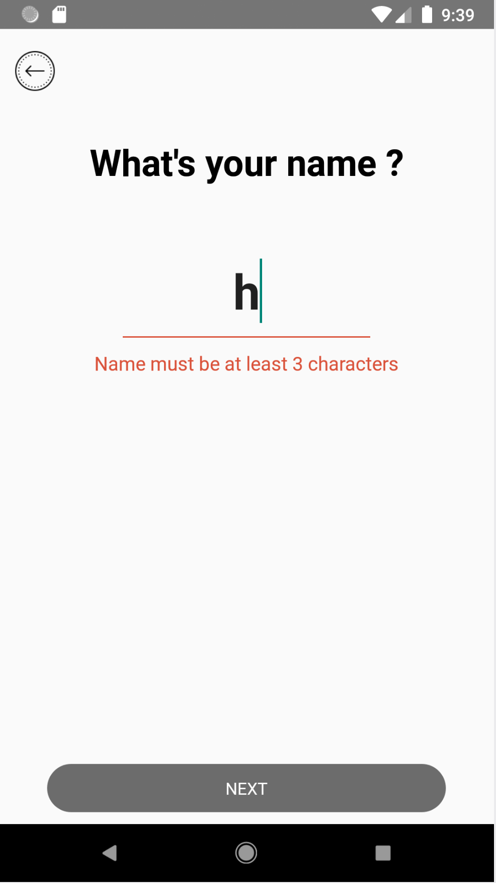
Validate your input TextField
//name and error are internal states
@State var name: String = ""
@State var error: String = ""
Button(action: {
print("next")
}) {
Text("NEXT")
.frame(maxWidth: .infinity,
minHeight: 50)
.foregroundColor(.white)
.background(error == "" && name.count > 0 ? Colors.primary : Colors.inactive)
.clipShape(
RoundedRectangle(cornerRadius: 25))
.padding(.leading, 10)
.padding(.trailing, 10)
}.padding(.bottom, 10)
.disabled(error.count > 0 || name.count == 0)
How to make this button “active” when “validation is OK” ?

Slide 14
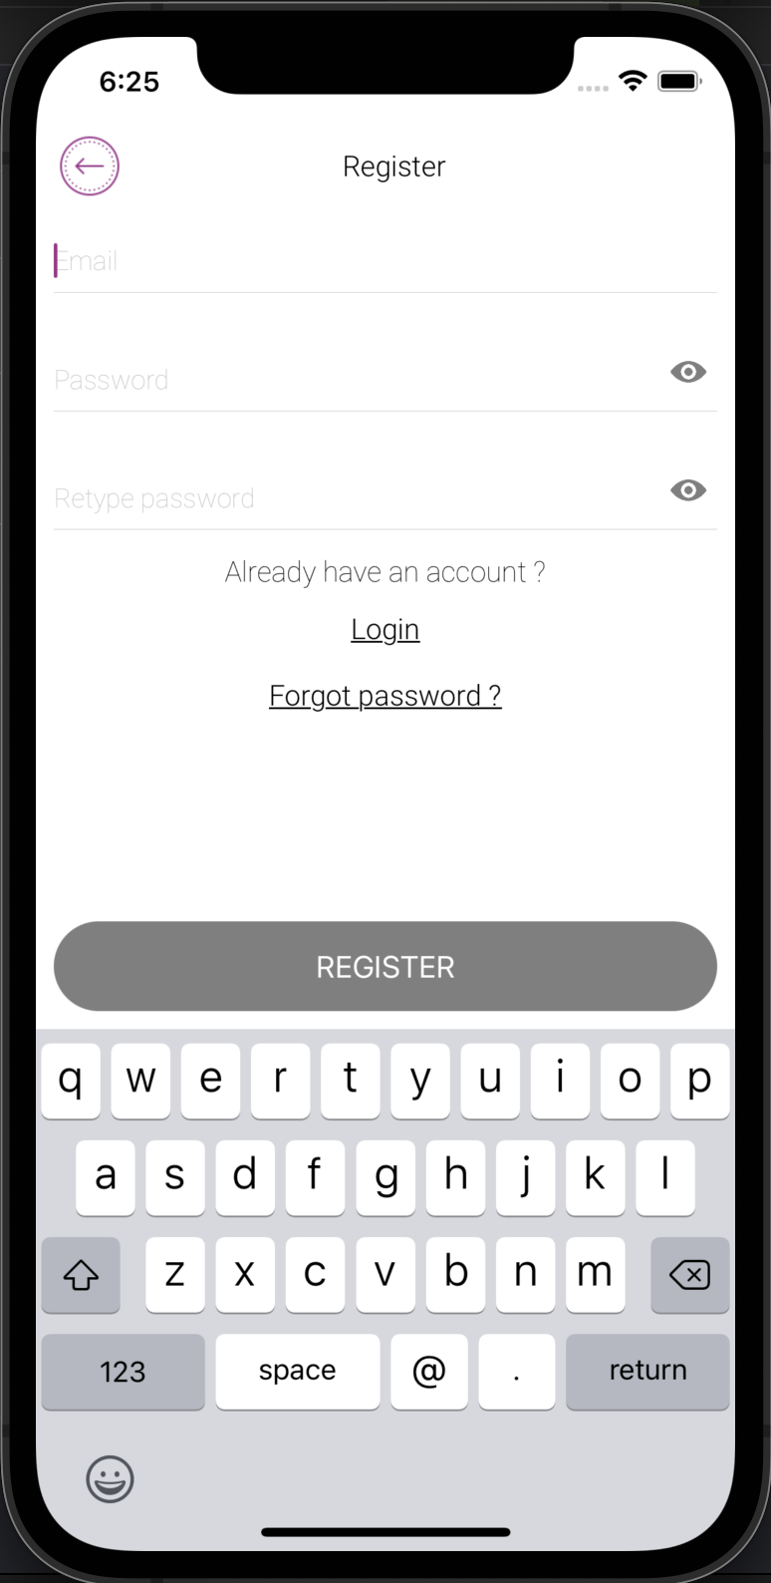
Example of Login/Register Screen
Write a Login/Register Component/Screen:
- Email TextField with Validation
- The “eye” icon shows/hides the Password
- Button “LOGIN/REGISER” is only “active” if validation is PASSED
- Back button “do nothing”, only show Alert, or print something

Slide 15
Register screen(TextField, @State,…)
VStack(alignment: .leading) {
//some code here...
}
UIHeader(
onPressLeft: {
print("left")
}, onPressRight: {
print("right")
}, title: "Register")
TextField("Email", text: Binding<String>(get: {self.email}, set: {
email = $0
errorEmail = (isValidEmail(email: email) == false) ? "Email is not in correct format" : ""
}))
TextField("Password", text: Binding<String>(get: {self.password}, set: {
password = $0
errorPassword = password.count == 0 ? "Password must not be blank" : ""
}))
.keyboardType(.default)
.disableAutocorrection(true)
.autocapitalization(.none)
.padding(.horizontal, 10)
.padding(.top, 10)
.multilineTextAlignment(.leading)
.font(Font.custom("Roboto-Thin", size: 15))

Slide 16
Register screen(eye icon, validation)
SecureField("Password", text: Binding<String>(get: {self.password}, set: {
password = $0
errorPassword = password.count == 0 ? "Password must not be blank" : ""
}))
.keyboardType(.default)
.disableAutocorrection(true)
.autocapitalization(.none)
.padding(.horizontal, 10)
.padding(.top, 10)
.multilineTextAlignment(.leading)
.font(Font.custom("Roboto-Thin", size: 15))
Button(action: {
passwordVisible.toggle()
}) {
Image(Icons.eye)
.renderingMode(.template)
.resizable()
.aspectRatio(contentMode: .fit)
.frame(height: 20, alignment: .topTrailing)
.foregroundColor(Colors.inactive)
}
.padding()
.offset(x: 0, y: 4)

Slide 17


